Slide 1
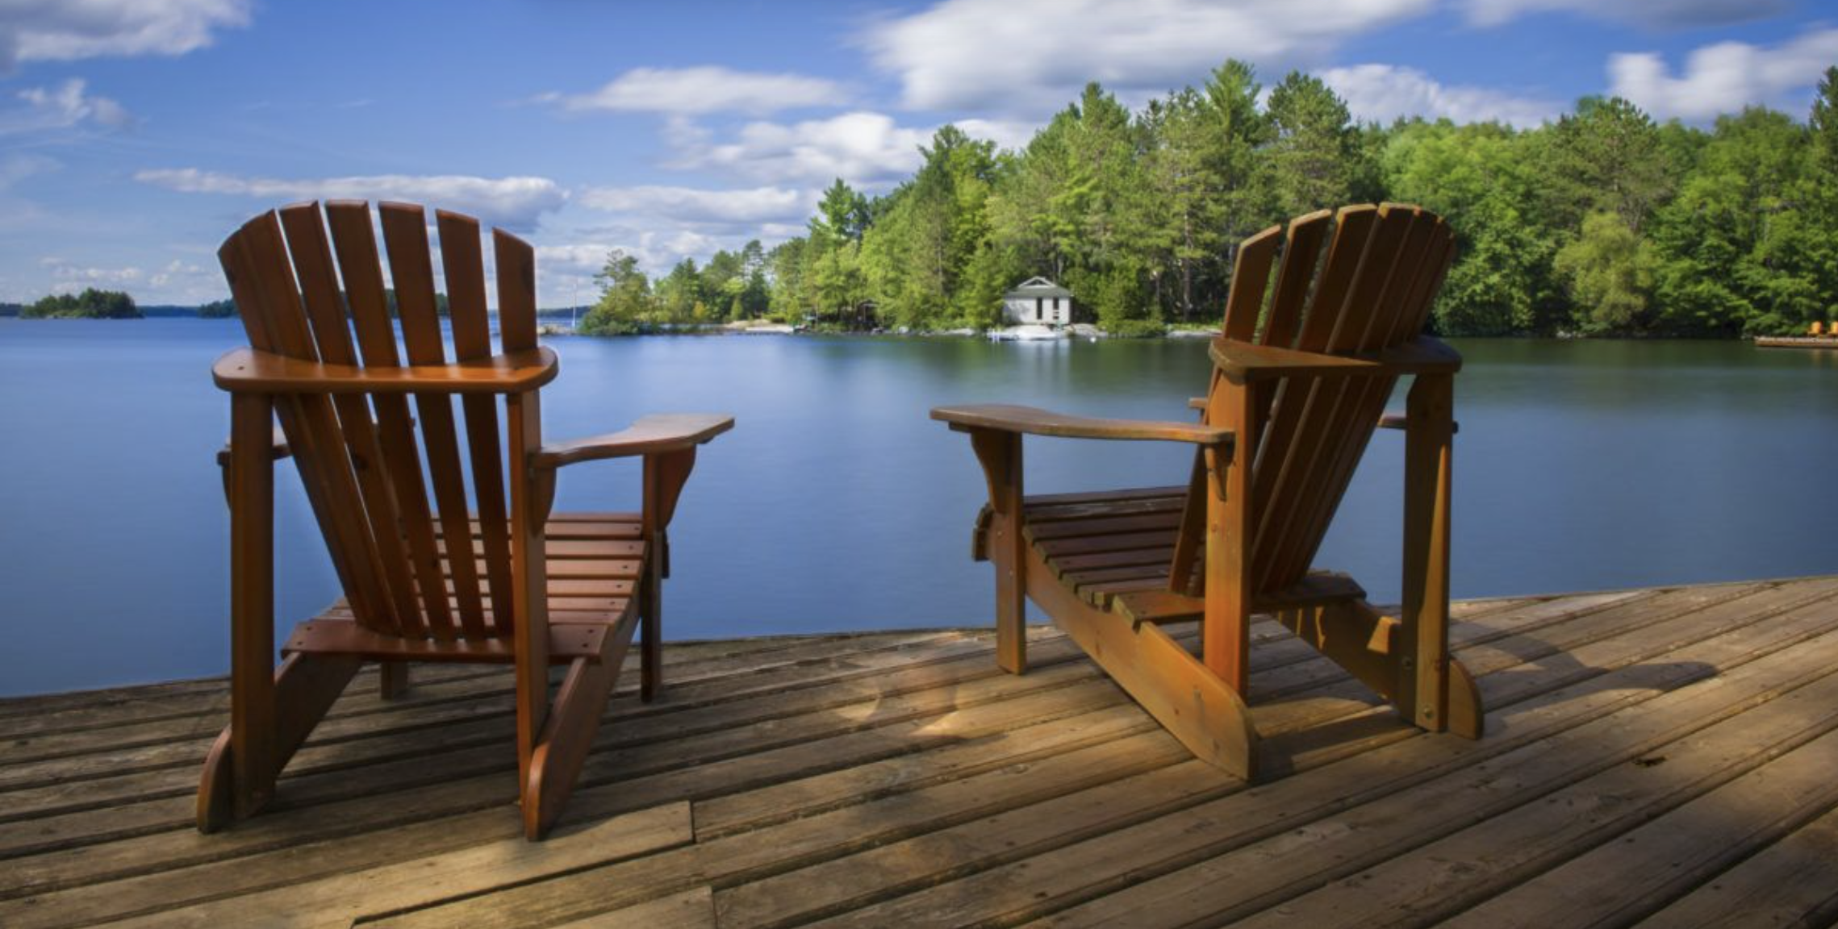
2022-23 Mississagua – Gold Lake Cottagers’ Road Group
Annual General Meeting

Slide 2

Meeting Protocol
(Aug 4, 2019 BY-LAWS )
Annual General Meeting is being conducted in compliance with the Aug 4, 2019 Mississagua – Gold Lake Cottagers’ Road Group Bylaws and the Ontario Not-for-Profit Act (ONCA) 2010
The following protocols were followed for the 2023 AGM
  Notice: Initial notice sent out via mailchimp July 13, 2023 (minimum of 21-day notice requirement)
  AGM Agenda posted to website (www.mglakeroadgroup.com) Aug 06, 2023
  Minutes of the 2022 AGM posted to the website.
  Quorum has been reached for this meeting
Notes:
My name is Warren Markwart and I am the chairperson
of the Mississagua – Gold Lake Cottagers Road Group
And this is the 2023 Annual General Meeting of the Mississagua – Gold Lake Cottagers Road Group
Which is being conducted in compliance with our Aug 4, 2019 bylaws
- the Ontario Not-for-Profit Act (ONCA)
And the Province of Ontario Emergency Legislation

Slide 3
AGENDA
Welcome and Chairperson’s Remarks
Current Board of Directors & Ratification of 2023-24 Board Nominees
Member Survey Results
Road Supervisor’s Report
Treasurer’s Report - 2022-23 Financials
Appointment of New Accountant
2023-24 Road Fees with 3 Year Financial Forecast
Member Questions Discussed
Voting Procedures
Notes:
the agenda today will
introduce the Current Board of Directors
And the new board members
Suzanne Vanderkaden who looks after communications will discuss the Annual Member oopinion Survey Results
Don Bartely , our road manager will detail the road maintenance activities, present and future
Robin Axon will report the
- 2022-23 Financial results
Review the Appointment of our New Accountant
Present the 2023-24 Road Fees
And a 3 Year Financial Forecast -
Joel Kruich will present
Member Questions and responses
And
Review The Voting Procedures

Slide 4
History of the Road
All the lots were subdivided in the 1950’s
All cottages were “Water Access Only” until 1992 when the road was constructed
Immediate increase in the value of all real estate.
Access is over a single bridge
The Highway Traffic Act is not applicable to the road system
The Municipality deems it to be a fire route
This is an Unassumed Road
Notes:
Today I want to share some of the history of the road system,
And To give perspective where we are today
What its take a volunteer organization to manage a 13 km road system
Which is one of the largest private cottage road systems in the province.
All the lots on this side of Mississagua Lake and Gold Lake were subdivided in the 1950’s
All cottages were “Water Access Only” until 1992 when the road was constructed
The road concept was driven by a small group of committed cottagers.
When the road opened it created a new level of enjoyment for cottagers and a
Immediate increase in the value of all real estate.
The Access to the entire road systems is over a single bridge.
It is the vital link to cottages and their real estate value.
The road has some unique characteristics
The Highway Traffic Act is not applicable to the road system
The Municipality deems it to be a fire route
This is an Unassumed Road, which mean use at your own risk

Slide 5
State of the road
This is a 30 year old gravel road that was built on logs, boulders, rock and mud
Never planned or designed to take the volume of traffic and the size and weight of the vehicles
Increasing volume in summer and winter – cottagers, visitors, park access
  Changing profile of the cottage owner
  Larger cottages are being built that are used all year round
  More visitors per cottage
  AirBnBs
  Construction /Contractors
  Service Vehicles
  Deliveries & Couriers
Notes:
This is a 30 year old gravel road that was built on logs, boulders, rock and mud
The road was planned by hiking through the bush following Fire Route 130 which was the access to the Fire Lookout Tower that was located at the top of tower hill
Never planned or designed to take the volume of traffic and the size and weight of the vehicles is handles today.
Original traffic on the road was primarily 3 seasons,
as cottages were not easily accessible in the winter.
Today there is an Increasing volume in summer and winter –
cottagers, their visitors, park access visitors
We have a Changing profile of the cottage owner
Larger cottages are being built that are used all year round
More visitors per cottage
AirBnBs, cottage rentals
Construction /Contractors
Service Vehicles
Deliveries & Couriers
All this volume adds additional stress on the road system
And the resources needed to maintain it.

Slide 6
Work of the Board
Member communication
  Website updates, website management
  Newsletters
  Road condition updates (twitter, website)
Administration
  Governance
  New member management
AGM preparation and execution
Vendor Management
Road Maintenance, upgrades
  Summer Maintenance (grading, gravel, potholes)
  Winter Maintenance (Plowing, sanding)
Financial Management
  Annual billing and collections (140 members)
  Banking and investments
  Forecasting and financial reporting
Notes:
The board is a group of volunteers who are your neighbours .
They collectively contribute hundreds of hours of their personal time
Using their skill, ability and experience
To manage the road system for all 140 members.
The last 3 opinion surveys have indicated a high degree of member satisfaction;
however, we also realise that it is hard to please everyone.
Our role is to balance the input & suggestions
that we receive with the financial resources we have.
We receive many positive and constructive suggestions that are reviewed and evaluated.
The Board performs many duties and has the following responsibilities.
Member communication
Website updates, website management
Current info about the road group
Bylaws
Newsletters
Winter Road operations updates (twitter, website)
Administration
Governance
Policy and procedures of the road group
documentation
New member management
AGM preparation and execution
Vendor Management
Road Maintenance,
upgrades
Summer Maintenance (grading, gravel, potholes)
Winter Maintenance (Plowing, sanding)
Financial Management
Annual billing and collections (140 members)
Banking and investments

Slide 7
Summer & Winter Maintenance
SUMMER MAINTENANCE
Al Mansell - Contractor for 30 years
Local operation
Grader by the bridge
3 years of programmed gravel with sand fines.
6 annual gradings - Planned
  Spring is a difficult time
    Thaw – Freeze road
    Potholes and bogs pits
  WINTER ROAD OPERATIONS
    Wes Lake – Contractor
    Local Operation
    Snow Plowing – fixed contract with Wes Lake ( 3 years )
    Traffic volumes change the snow into a skating rink.
    Sanding – we pay for spreading the sand - $400 per load
      Municipality provides it “free”
        ( nothing is free with a government)
Notes:
We are fortunate to have 2 very reliable contractors that provide us with summer and winter maintenance operations.
Al & Wes are local and have an extensive understanding of the conditions of the road, their equipment is close by and they understand the delicate balance between gravel, grading and potholes as well as ploughing sanding and ice.
SUMMER MAINTENANCE
Al Mansell - Contractor for 30 years
Local operation
Grader by the bridge
We have just completed 3 years of programmed gravelling for the Main road and the spurs
We used a better quality gravel with sand fines that packs firmer and is less dusty.
6 annual gradings - Planned
Spring is a difficult time
Thaw – Freeze road
Potholes and bogs pits
WINTER ROAD OPERATIONS
Wes Lake – Contractor
Local Operation
We have a fixed cost snow plowing contract with Wes Lake renews every 3 years.
Traffic volumes change the snow into a skating rink.
For Sanding – we pay Wes for spreading the sand - $400 per load
Municipality provides it “free” which Wes stores in a special sand facitlity
( nothing is free with a government)

Slide 8
New Bridge Contract with the MNRF
  The Bridge
    Ministry of Natural Resources lease agreement
    30 years
    Fee from $226 per year to $1,926 per year
  The Road
    Land use permit
    No fee
    Must allow access to the general public
Notes:
The Bridge
Ministry of Natural Resources lease agreement for the specific area that the bridge occupies.
The original 30 years lease has expired in 2022 and will expires again in 2052.
The lease Fee has increased from $226 per year to $1,926 per year
About $12 per member per year for each of the 140 members.
The Road
Land use permit
We do not pay a fee for the land the road is constructed on.
But we Must allow access to the general public.

Slide 9

Current 2022-2023 Board of Directors
 | Position | Cottage Location | Time Left on the Board
Don Bartley | Road Manager | Spur 6 | 2 years
Robert Brazzell | Governance | FR - 130 | 2 years
Ian Colquhoun | Secretary & Environment | Spur 7 | 2 years
Catherine Rice | Finance | FR - 130 | 1 year
Warren Markwart | Chair | Spur 4 | 1 year
Suzanne Vanderkaden | Communications & Nominations | FR - 130 | 1 year
Steve Quinlan | Treasurer | Spur 1A | 0 years / 3 years
Robin Axon | Vice Chair & Finance | Spur 8 | 0 years
Joel Kruzich | Membership | Spur 7 | 0 years
Notes:
I would like to thank and acknowledge the time and commitment from these Board members this year.
Don Bartley
Road Manager
Robert Brazzell
Governance
Ian Colquhoun
Secretary & Environment
Catherine Rice
Finance
Warren Markwart
Chair
Suzanne Vanderkaden
Communications & Nominations
Steve Quinlan
Treasurer
And a special thanks to 2 departing Board Members after 3 years of service
Robin Axon
Vice Chair & Finance
Joel Kruzich
Membership management.

Slide 10
NEW BOARD for 2023-24
 | Position | Cottage Location | Time Left on the Board
Don Bartley | Road Supervisor | Spur 6 | 2 years
Robert Brazzell | Governance | FR - 130 | 2 years
Ian Colquhoun | Secretary & Environment | Spur 7 | 2 years
Suzanne Vanderkaden | Communications & Nominations | FR - 130 | 1 year
Warren Markwart | Chair | Spur 4 | 1 year
*Catherine Rice | Finance | FR - 130 | 1 year
*Steve Quinlan | Treasurer | Spur 1A | 3 years
*Kick Vanluden | Finance | Spur 9 | 3 years
*Dan Charlebois | Road Committee | Spur 8 | 3 years
MOTION: The *nominees for the 2023-2024 board are to be ratified as presented.
Notes:
Here is your new 2023 -2024 Board.
The Board Member nominees are:
*Catherine Rice
Finance
Joined the board during the year and will serve for another year
*Steve Quinlan
Treasurer
Has volunteered to stay on for another 3 year term
Welcome to our 2 new members -
*Kick Vanluden
Finance committee
*Dan Charlebois
Road Committee

Slide 11

Road Supervisor’s Report
  2022-23 IN REVIEW
  New gravel on the Spurs
    First time in many years this has been done
  Culverts Repaired
    Ongoing
  Overview of Summer and Winter Maintenance
  PROJECTS FOR 2023-24
  Culvert replacement
    Beaver flats between Spur 3 & 4.
    Beaver point on FR 130 before the Spur 4 hill.
  Foliage Management Plan
    Tree Trimming, Corners, Width
    Planning early work for Fall
    Talking to contractors – balance environmental, cost scope and safety
  Guard rails
    FR 130 hill at Spur 1A
  Signage
    Unassumed Road
    Traffic Management
Notes:
Hi everybody, it’s Don Bartlett from Spur 6. I hope everybody’s been enjoying the new gravel that’s been put on the main road and spurs. This was long overdue.

Slide 12
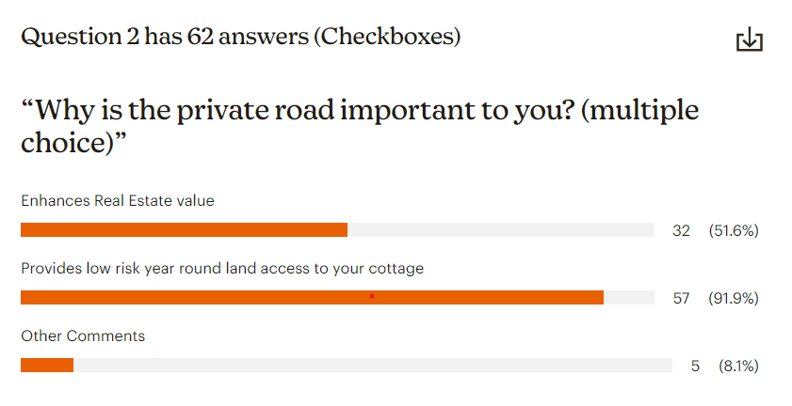
Member opinion survey – response rate/why important:
Member opinion survey
RESPONSE RATE / WHY IMPORTANT
Response Rate:
2023:
As of July 29th, 62 responses or 44%
2022:
At time of AGM, 93 responses or 66%
Response Rate:
Fewer cottagers completed survey in 2023.
Statistically considered a very strong response rate.
Why Important?
Consistent with 2022, year round access to your cottage number is #1 choice

Slide 13
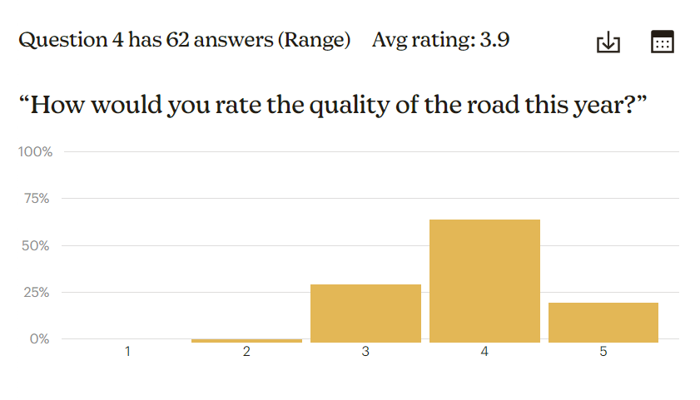
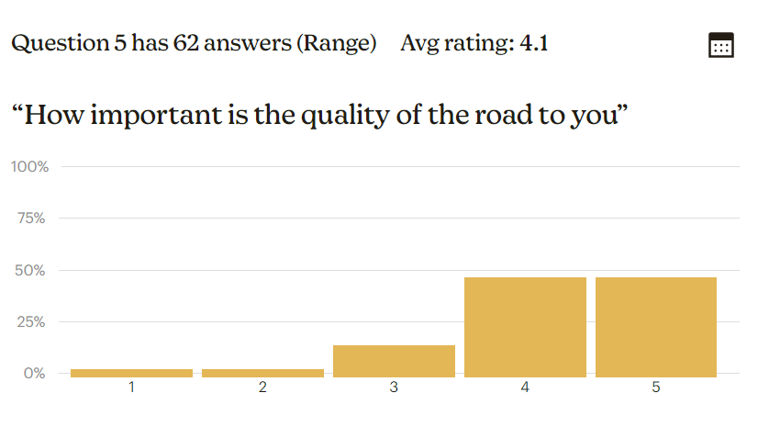
Member opinion survey –quality of the road:
Member opinion survey
QUALITY OF THE ROAD
Slight improvement compared to 2022 (3.8 to 3.9)
Improved pothole management
Additional graveling on spurs appreciated
Urgent requirement for brush trimming especially on blind corners

Slide 14
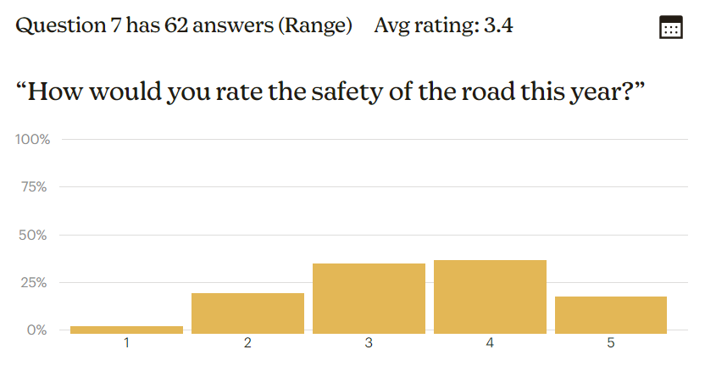
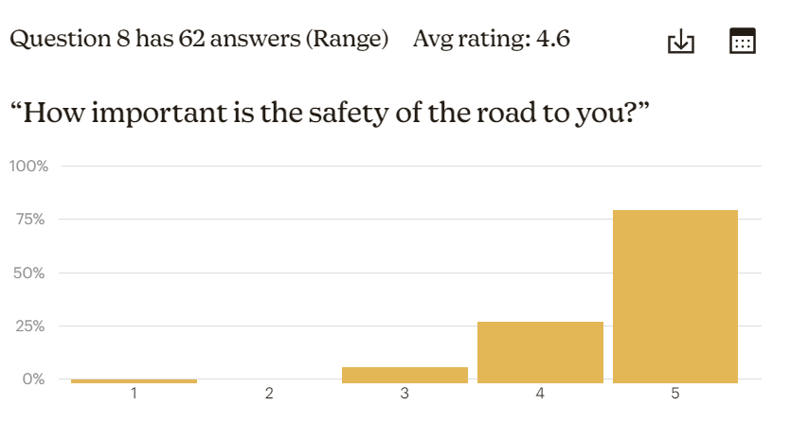
Member opinion survey – Safety of road:
Member opinion survey
SAFETY OF THE ROAD
Slight decrease compared to 2022 (3.6 to 3.4)
Safety is of prime importance - 68% of respondents rated safety as a 5/5
Speed of drivers on the road – everyone needs to slow down! (Consistent from 2022 survey)
Blind Corners – clear foliage/brush (significantly more comments in 2023 when compared to 2022)

Slide 15
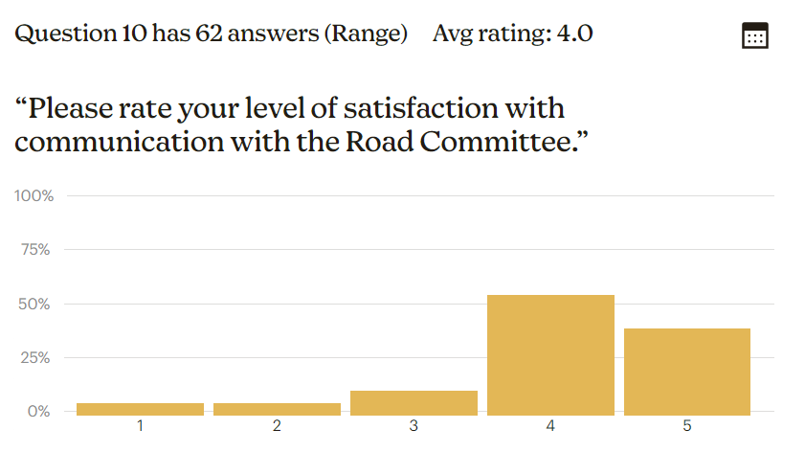
Member opinion survey – communication:
Member opinion survey
COMMUNICATION
Rating consistent with 2022 survey results (4.0)
Positive feedback wrt Twitter

Slide 16
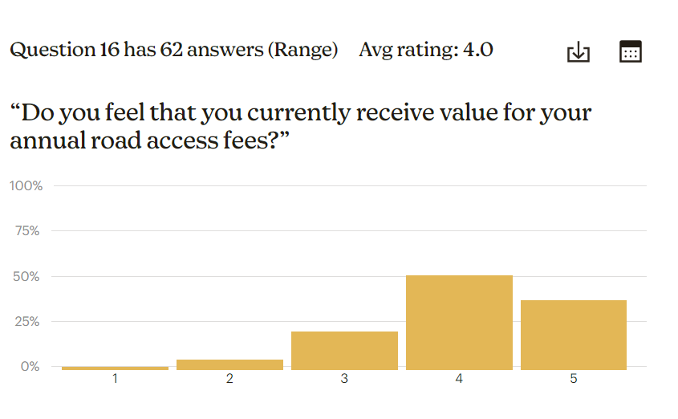
Member opinion survey – priorities/value:
Member opinion survey
PRIORITIES / VALUE
Road Priorities (select top 2):
Do you support allocation of resources (time and money) for turtle signs:
Additional Winter | 19 | 31.1
Pothole Management | 36 | 59
Tree and Weed Management | 28 | 45.9
Bind Corners | 38 | 62.3
Yes | 33 | 54.1
No | 26 | 42.6
Road Priorities:
Top 2 choices were:
  Pothole Management
  Blind Corners
Allocation of Resources for Turtle Signs:
Comments pertaining to cost effective solutions
Some mentioned focusing on speed of drivers would address the issue
Value Received from Annual Fee:
Slight decrease from 2022 survey (4.1 to 4.0)

Slide 17

ATTENTION: NEW MGLCRG accountant
Mark Lahn, CA
Professional Accountant, VP Finance
(20+ Years in leading finance position)
Replaced Dan Whatman during the 2022-23 season
Same cost as Whatman
Assuming more responsibilities (issuing cheques, etc)
More responsive and reliable especially as it pertains to the timing of year end reporting
Notes:
Hi, I’m Robin Axon and I will be presenting the financial portion of the Road Group’s operations today from my cottage on Spur 8. I’d like to start by introducing our new accountant Mark Lahn. Mark replaced Dan Whatman this year and brings decades of experience managing finance for businesses like ours and is very excited to be a part of team.

Slide 18
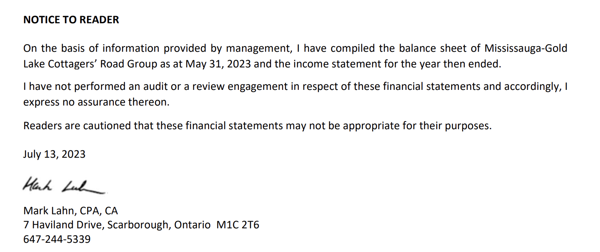
2022-23 treasurer’s report
Notice to reader
Notes:
Here is the customary notice to reader statement that describes the level of detail for which Mark provided his services.

Slide 19
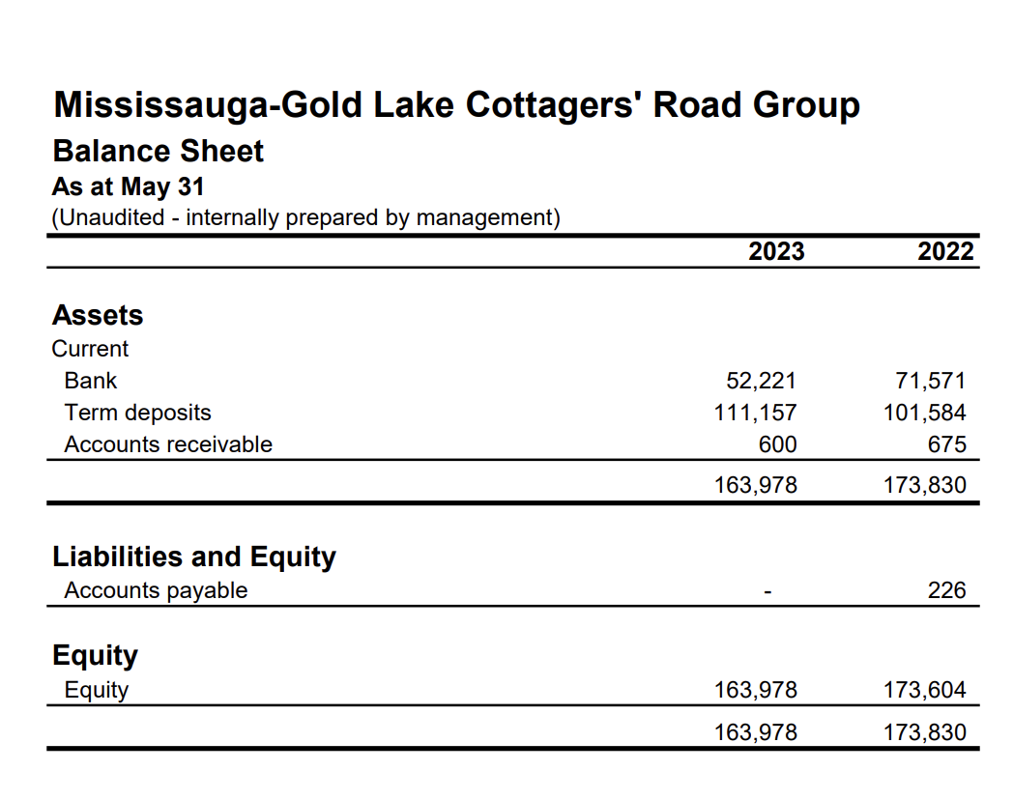
Treasurer’s report
Balance sheet
Notes:
Here is a view of the Road Group’s balance sheet as of May 31, 2023. Here you can see the bank balance, which is our operating account where your fees get deposited and from where we pay our contractors. The Term Deposits are simply another bank account that allows us to earn interest on money that we won’t need during the year for operations. We will refer to this a little later as our Reserves account. As a reminder, we keep approx. 100k in reserves in case of an emergency situation such as problems with our bridge. As Warren discussed, the bridge is a single point of failure for our entire road system.

Slide 20
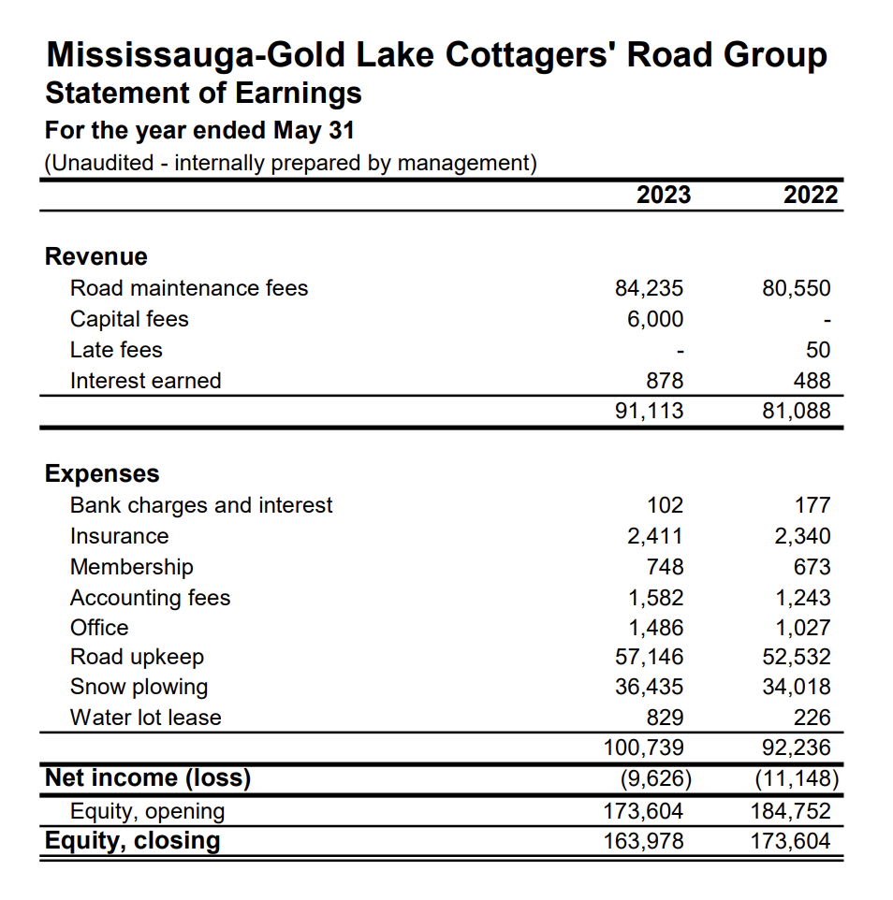
Treasurer’s report
INCOME STATEMENT
Notes:
This is our Earning statement which allows us to see the breakdown of all money flowing into and out of our bank accounts throughout the year. Starting with Revenue, you can see that we collected 84.235 in fees this year as well as 6000 that was collected as a new capital fee from a cottager that had previously not paid their initial payment. The final revenue item you can see is the interest we earned on the money that was sitting in our reserves. Moving on to the expenses, these are all of the expenses that we incurred during the year. An easy way to understand these expenses is to look at them as three types of expenses. Looking down the list a bit you’ll see Road Upkeep - this is essentially all of the summer maintenance like graveling and grading and any road improvement expenses that we had in the year and as Warren mentioned, this is primarily done by Al Mansell. Next you’ll see snow plowing – this is all of the winter maintenance done by Wes Lake during the winter. If you take all of the other expenses together, these represent our G&A expenses which are things like bank fees, insurance, accounting, software and back office costs as well as the new bridge lease that was mentioned earlier. This statement also allows you to see the year over year changes to all of these costs. Here you can see the slight increase in cost of our summer and winter maintenance as well as all of the G&A expenses. The biggest factor affecting our maintenance increases is simply inflation and the increased costs of materials and fuel. The primarily driver affecting our G&A expenses was obviously the increased cost of our new bridge lease.

Slide 21
2022-2023 Financial Highlights
More revenue from collection of unexpected capital fees.
Expenses up year over year but lower than budget
Net loss better than budgeted.
Total cash down due to graveling program, but less than budgeted as noted due to capital fees.
GREEN – BETTER THAN BUDGET
RED – WORSE THAN BUDGET
Notes:
This is just another view of the exact same numbers but in a format that we use to our planning for future years. In this table you can see the budget we presented to you last year and how things played out in the Actuals column. As you can see we collected more revenue than expected due to the unexpected capital fee and we spent 7% less than we expected on our expenses for the year. So the good news is that even with the investment in new gravel for the road that we did, our total cash plus reserves is only down 10k from last year even though we expected to be down over $20k.

Slide 22
3 Year FINANCIAL Forecast
Proposed Fee Increased to $650
Expenses expected to increase significantly:
Inflation (new contracts)
New Bridge Lease
Brushing
Signs
Attempting to keep total cash balanced to maintain operating cash and reserves
Notes:
This table should be familiar to you as it’s the same format as the last slide, and the same format that we used to present our 3 year budget to you last year. In the sold blue area you’ll see the 2023-24 budget we presented to you last year and some of the changes that we are anticipating. First, you’ll notice that we are expecting our expenses to be almost 20% higher than we originally predicted. This is mostly due to inflationary increases from our contractors and materials, but it also includes an increased allocation of dollars to the road improvement expenses budget so that we set aside some cash to begin our brushing program in the fall. Unfortunately, the anticipated increase in our expenses means a slightly higher than expected increase in our fees this year. We are proposing a $50 fee increase this year to $650 as shown in the table. An interesting reminder when looking at this increase is to remember that the new bridge lease that we are paying represents $12 per cottager of the fee increase alone.
If you look at the columns for 2024 and 2025, you’ll see the good news is that we are anticipating to be back on track for a smaller increases starting again next year.

Slide 23
Financial MOTIONS
MOTION: That the 2022-2023 financial statements be accepted and approved as presented.
MOTION: That the 2023-2024 Road Fee be set at $650 as discussed in the previous slide.
MOTION: That Mark Lahn be appointed to review the financials
for the 2023-2024 fiscal period.
Notes:
So to summarize the motions that will come as a result of the information you just saw, there are 3 motions being presented here. 1, 2 and 3. Catherine Rice will go over the voting procedures at the end of the presentation. Next up is Joel Kruzich to answer the member questions that were sent in to us ahead of this year’s AGM.

Slide 24
Member questions for agm:
Why is the AGM been held via Zoom again this year?
Why did MGLCR Board not dispose of Abandoned Paddle Boat on the side of the road by Spur 6 split?
When is the Road Group planning to do the brush clearing on the road?
Why are Road Maintenance costs increasing?
Why did Office Costs increase and what is included in this category?
Notes:
Special thanks to question askers: Kris Roze, Don and Krystal Groves and a few others.
Zoom – your call
Paddle – your call
Brush clearing plan is still being developed but balancing between cost, scope and environment concerns. Hoping to start in the fall.
Road costs are increasing as they do every year due to inflation. We are renewing the winter contract this year and expect due to rising operating costs that this will go up approx. 10% over the previous years. We do believe we have the best most cost effective contractors possible for all of our road maintenance.
Office – Robin talked about this earlier and this is less than 2% of our budget so is not something we spend much time thinking about.

Slide 25
Voting procedures
Shortly after this meeting you will receive an email with a link.
Only one vote per cottage will be eligible.
The motions to be voted on were outlined in the presentation as:
  Ratification of new director slate.
  Financial statements for last fiscal period
  Appointment of accountant for next year and
  Support of 2023-24 Road Fee of $650.
You must choose either; in favour, opposed or abstain for your vote to be eligible.
Online voting will close at 5pm on August 18, 2023,

Slide 26

adjournment
Notes:
Warren
Thank you for attending this years AGM.
This presentation will be available for playback from a link on our web site.
Hopefully the world will be a more normal place for the 2023 Annual General Meeting.
As with many things,
We have learned different methods for presenting and communicating to the membership

Slide 27
adjournment
Notes:
Warren
Thank you for attending this years AGM.
This presentation will be available for playback from a link on our web site.
Hopefully the world will be a more normal place for the 2023 Annual General Meeting.
As with many things,
We have learned different methods for presenting and communicating to the membership

